Slide 1

A PRACTICAL TRAINING PRESENTATION
“ON CDMA TECHNOLOGY”
BY-
VIJAY YADAV
IV YR, ECE DEPT.,SECTION -B
www.powerpointpresentationon.blogspot.com
18/11/2009

Slide 2

CONTENTS
STAGE # 1
  COMPANY PROFILE
  TTSL AT JAIPUR
  AWARDS & RECOGNIZATION
  OTHER SERVICES
STAGE # 2
  CELLULAR COMMUNICATION
    Multiple Access Method
    CDMA Introduction
  CDMA NETWORK ARCHITECTURE
  CALL PROCESSING IN CDMA NETWORK
18/11/2009

Slide 3
STAGE#1
18/11/2009

Slide 4

Company’s Profile
Established in : 1996
Chairman & M.D. : Mr. Ratan .N. Tata
CEO & Joint Managing Director : Mr. Anil Kumar Sardana
Employees : 3,50,000
Proportionate Revenue : $ 62.5 Billion
Shares in Issue : 3.2 Million in June 2008
18/11/2009

Slide 5

Training undertaken at :
        TATA TELE SERVICES LIMITED,
        THE GUMAN-I, AMPRAPALI CIRCLE,
        VAISHALI NAGAR, JAIPUR
H.R. Manager : Mr . Amit Agarwal
Reporting officer : Mr. Rahul Sharma
Co-persons : Mr.ShishirDhandholiya
Mr. Abhay Agarwal
18/11/2009

Slide 6


TTSL Has Won the GLOBAL HR EXCELLENCE AWARD 2009 under the “INSTITUTION BUILDING CATEGORY” BY WORLD HRD CONGRESS
100 TRUE VALUE SHOPEES(TVS) ON THE SAME DAY ACROSS THE NATION
INNOVATIVE RETAIL CONCEPT OF THE YEAR 2008
18/11/2009

Slide 7

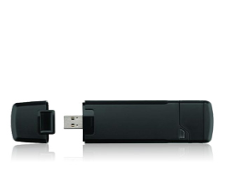
Other Services
TATA TELEMEDIA SERVICES
High Speed Broadband Internet Services
Landline service in around 102 cities
Direct to Home (DTH) Service in over 87 Cities
ENTERPRISE SERVICES
Provides a broad portfolio of services to large Enterprise and Carrier customers.
2 This division comprises of the Carrier and Corporate business unit.
18/11/2009

Slide 8

18/11/2009

Slide 9

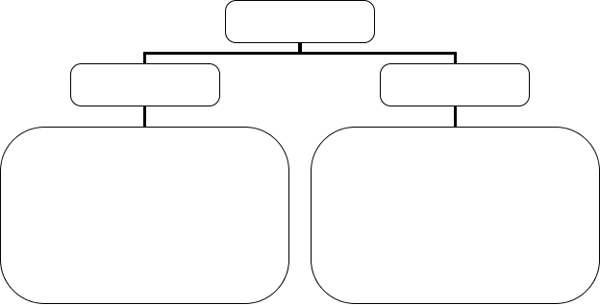
Technologies
TDMA/FDMA
CDMA
GSM (European Standard)
IS 136 (U.S Standard)
PDC (Japnese Standard)
IS 95 (U.S Standard)

Slide 10





Evolution of Cellular Systems
3rd. Generation
(2000s)
2nd. Generation
(1990s)
1st.Generation
(1980s)
IMT-2000
CDMA2000
W-CDMA
Digital
GSM DECT
DCS1800 CT2
PDC PHS
IS-54
IS-95
IS-136
UP-PCS
Analog
NMT CT0
TACS CT1
AMPS

Slide 11











PN Code
Freq
Freq
Freq
Time
Time
Time
FDMA
TDMA
CDMA

Slide 12

In FDMA, the entire allocated cellular frequency spectrum is divided into a number of 30-kHz channels .
The power transmitted by a cell is only large enough to communicate with mobile stations located near the edge of the cell’s coverage area.
The radius of a cell might be one mile or less-referred to as a small cell.
18/11/2009

Slide 13

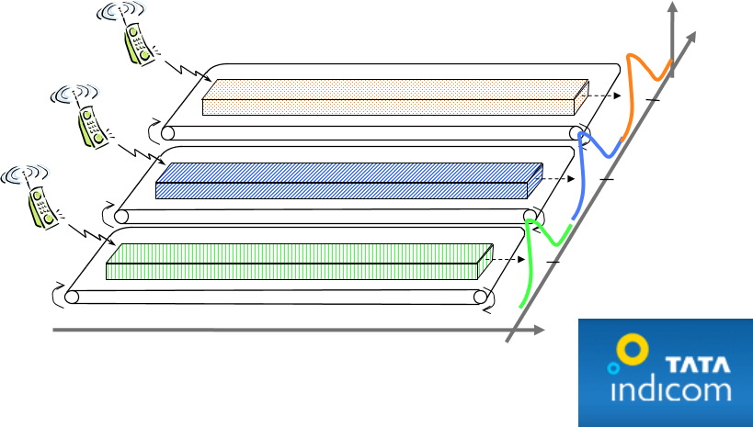
FDMA Overview
Frequency
C
C
f
2
B
B
f
1
A
A
f
0
Time

Slide 14

TDMA is a digital wireless air interface .
It divides each carrier frequency into a number of time slots, each of which constitutes an independent telephone circuit.

Slide 15
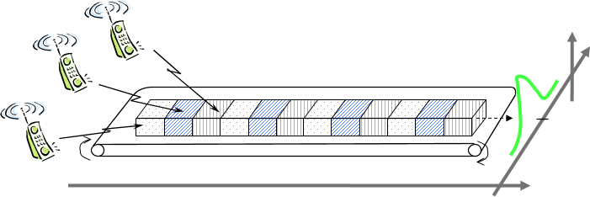
TDMA Overview
Frequency
A
B
f
C
B
A
C
B
A
C
B
A
C
B
A
0
C
Time

Slide 16

A digital multiple access technique specified by the Telecommunications Industry Association (TIA) as "IS-95."
One of the unique aspect of CDMA is that while there are certainly limits to the number of phone calls that can be handled by a carrier, this is not a fixed number .
Code division multiple access (CDMA) is a digital air interface standard, claiming eight to fifteen times the capacity of analog.
18/11/2009

Slide 17

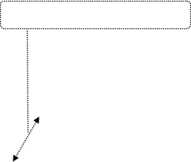
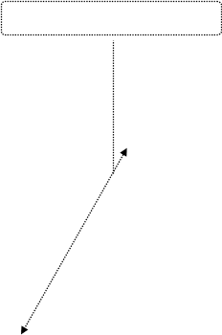
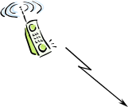

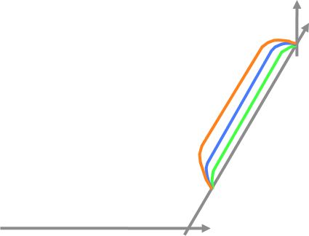

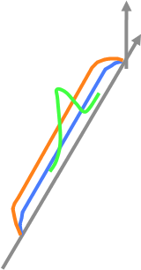
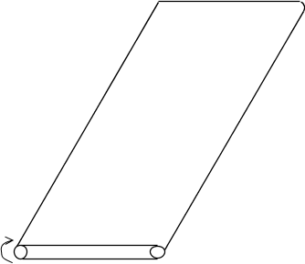
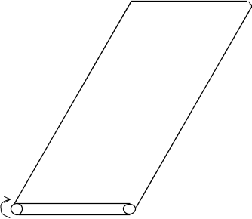
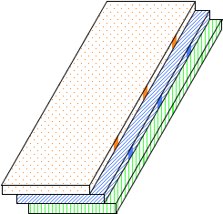
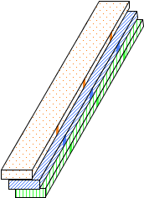

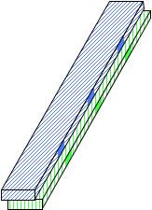
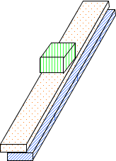
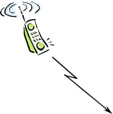







What is CDMA ?
spread spectrum
Base-band Spectrum
Radio Spectrum
Code B
B
Code A
B
Frequency
Code A
A
A
B
C
C
C
A
B
B
B
A
A
A
C
B
Sender
Time
Receiver

Slide 18







Classification of CDMA Systems
CDMA SYSTEMS
CDMA
one
CDMA
2000
Wide Band
IS95
IS95B
JSTD 008
Narrow Band

Slide 19
Multiple Access in CDMA:
  Each user is assigned a unique PN code.
  Each user transmits its information by spreading with unique code.
  Direct Sequence spread spectrum is used.
  Users are seperated by code not by time slot and freq slot.
18/11/2009

Slide 20




Concept of CDMA
  Users share same
  bandwidth
  User axis shows
  cumulative signal strength
  of all users
User
Code 4
Code 3
Code2
Code 1
Freq

Slide 21














General Architecture Of CDMA
BSC
HLR
VLR
BTS
SIM
MSC
PSTN,
ISDN
BTS
BSC
ME
EIR
AuC
Abis
Um
A
NS
BSS
MS
Base Station Subsystem
Network
Subsystem
Mobile station

Slide 22

Mobile Station (MS): Two Blocks
  Mobile Equipment (ME)
  Subscribers Identity Module (SIM)
Function of Mobile Station:
1. Personal Mobility
2. IMEI (International Mobile Equipment Identity)
3. IMSI (International Mobile Subscriber Identity)
18/11/2009

Slide 23


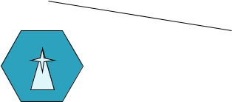

Base Station Subsystem (BSS)
  Base Transceiver Station (BTS)
  Base Station Controller (BSC)
BSC
18/11/2009

Slide 24

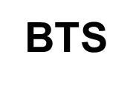
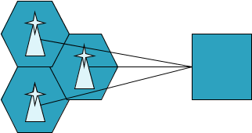
BSC
BTS : Base Tranceiver station
1. It defines the cell .
2. It handles the radio link protocol with the mobile station
BSC: Base station Controller
1. It manages radio resources for one or more BTS.
2. Allocation and Deallocation of channels.
3. Transmitter power control.
4. Handoff control

Slide 25






VLR
HLR
PSTN,
ISDN
BSC
MSC
EIR
AuC
Network Subsystem
  MSC: Mobile Switching Center
  HLR: Home Location Register
  VLR: Visitor Location register
  AuC: Authentication Center
  EIR: Equipment Identity Register
18/11/2009

Slide 26
Mobile Switching center:(MSC)
1 Call set up/supervision/release
2 Call routing
3 Billing information collection
4 Mobility management
5 Paging, Echo cancellation
connection to BSC, other MSC and other local exchange networks
6 Access to HLR and VLR
18/11/2009

Slide 27
Home Location Register (HLR)
1 One HLR per CDMA operator
2 Contains permanent M database of all the subscribers in the network
3 Contains MSRN(mobile station routing no.)
4 It is reffered for every incomming call
18/11/2009

Slide 28
Visitor Location Register(VLR)
1. Temporary visitors database
2. One VLR per MSC
Authentication Center(AuC)
1. Provides security
2. Authentication and encryption
Equipment Identity Register:
1. Contains IMEI
18/11/2009

Slide 29









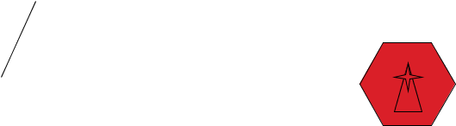










Handoff
GMSC
Handoff is of
3 types
1. Intra BSC
2 Inter BSC
3. Inter MSC
MSC
MSC
BSC
BSC
BSC
18/11/2009

Slide 30

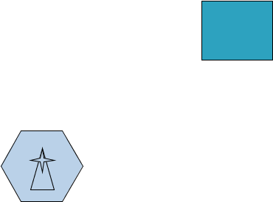








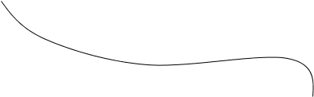
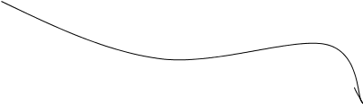



Location Update
VLR
BSC
MSC
GMSC
HLR
BSC
MSC
PSTN.
ISDN
VLR
18/11/2009

Slide 31
Comparison between CDMA and TDMA/FDMA:
In TDMA Band width available for transmission is small which leads to compromise in quality of transmission. Whereas in CDMA systems entire spectrum is used which enhances voice quality.
In TDMA/FDMA, cell design requires more frequency planning which is tough job. Whereas in CDMA frequency planning is minimal.
TDMA is Band limited system. CDMA is Power limited system
18/11/2009

Slide 32
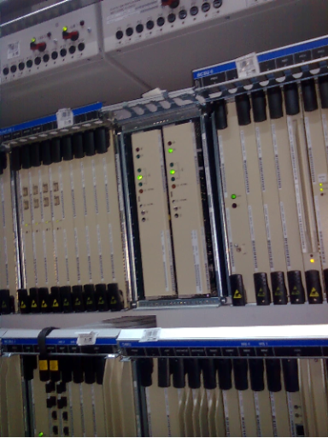
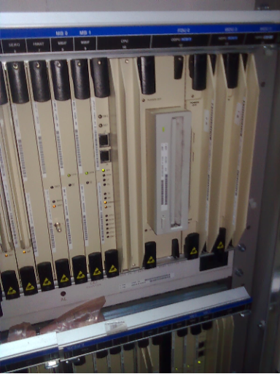
Some Pics Of BSC
18/11/2009

Slide 33
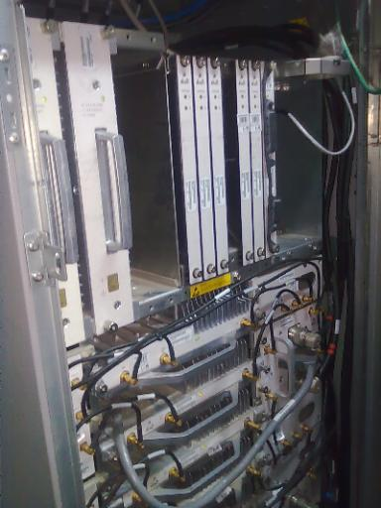
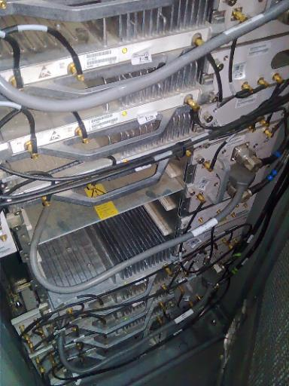
Some Pics Of BTS
18/11/2009

Slide 34
CDMA
ADVANTAGES OF CDMA
Increased Cellular Communication Security.
Soft Handoff Because Of Same Carrier Frequency
Increased Efficiency, Meaning That The Carrier Can Serve More Subscriber.
Smaller Phones.
Low Power Requirements And Little Cell-to-Cell Coordination Needed By Operators.
Extended Reach - Beneficial To Rural Users Situated Far From Cells.
18/11/2009

Slide 35
CDMA
DISADVANTAGES OF CDMA
NEAR FAR PROBLEM.
CDMA IS RELATIVELY NEW, AND THE NETWORK IS NOT AS MATURE AS GSM.
CDMA CAN NOT OFFER INTERNATIONAL ROAMING, A LARGE GSM ADVANTAGE.
18/11/2009

Slide 36
Conclusion
CDMA cellular system is deemed superior to the FDMA and TDMA cellular systems for the time being.
2. Therefore, CDMA technique becomes more important in radio communication systems.
3.CDMA is based on the spread spectrum technique which has been used at military field.
18/11/2009

Slide 37

18/11/2009

